Slide 1
Team-22
Simulating Drip Irrigation (DI) System For Optimizing Water Use Efficiency
Labiba Tasfiya Jeba ; ID: 22266028
Abrar Al Sayem ; ID: 18201194
Tasfia Anika Bushra ; ID: 23166013
ST: Farah Binta Haque
RA: Md Sabbir Hossain

Slide 2
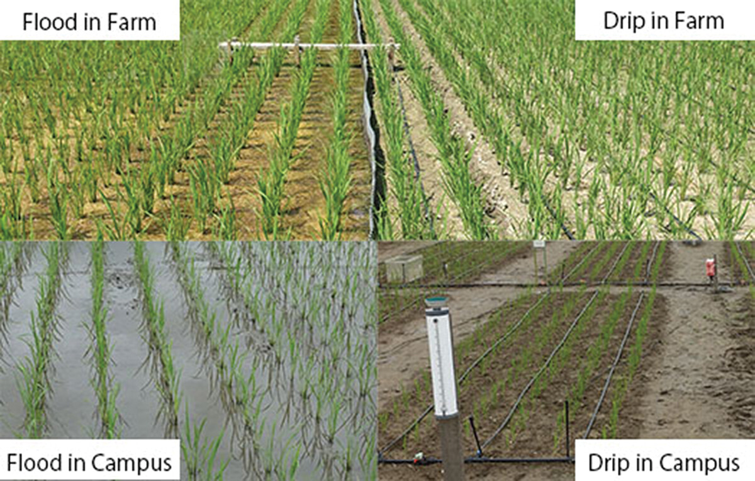

Slide 3
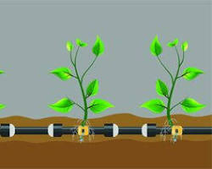
Advantages of Drip Irrigation
High water use efficiency
Reduced soil erosion
Improved Crop Yields and Quality
Reduced Fertilizer Use

Slide 4
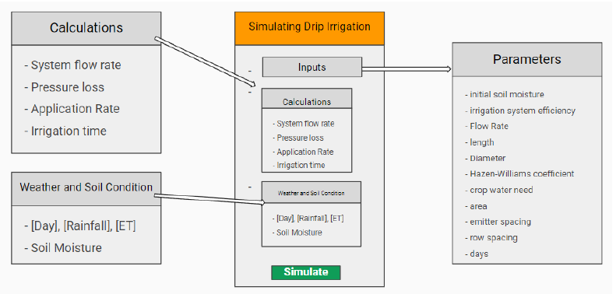
METHODOLOGY
Fig 1: Simulation Model

Slide 5
Data Collection and Calculation
System Flow Rate: Flow Rates (FR) for each emitter using a uniform distribution between 0.5 and 1.0 gallons per hour (GPH)
Pressure loss and Specifications: Length of the irrigation line (200 feet), diameter of the line (0.75 inches), Hazen-Williams coefficient (C, set at 140)
Crop Water Need and Area Coverage: The model considers a crop water need of 1.0 inch per week and an area of 1000 square feet

Slide 6
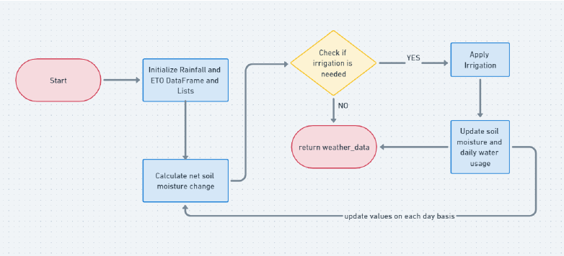
Weather and Soil Data
Fig 2: Weather and Soil Condition

Slide 7
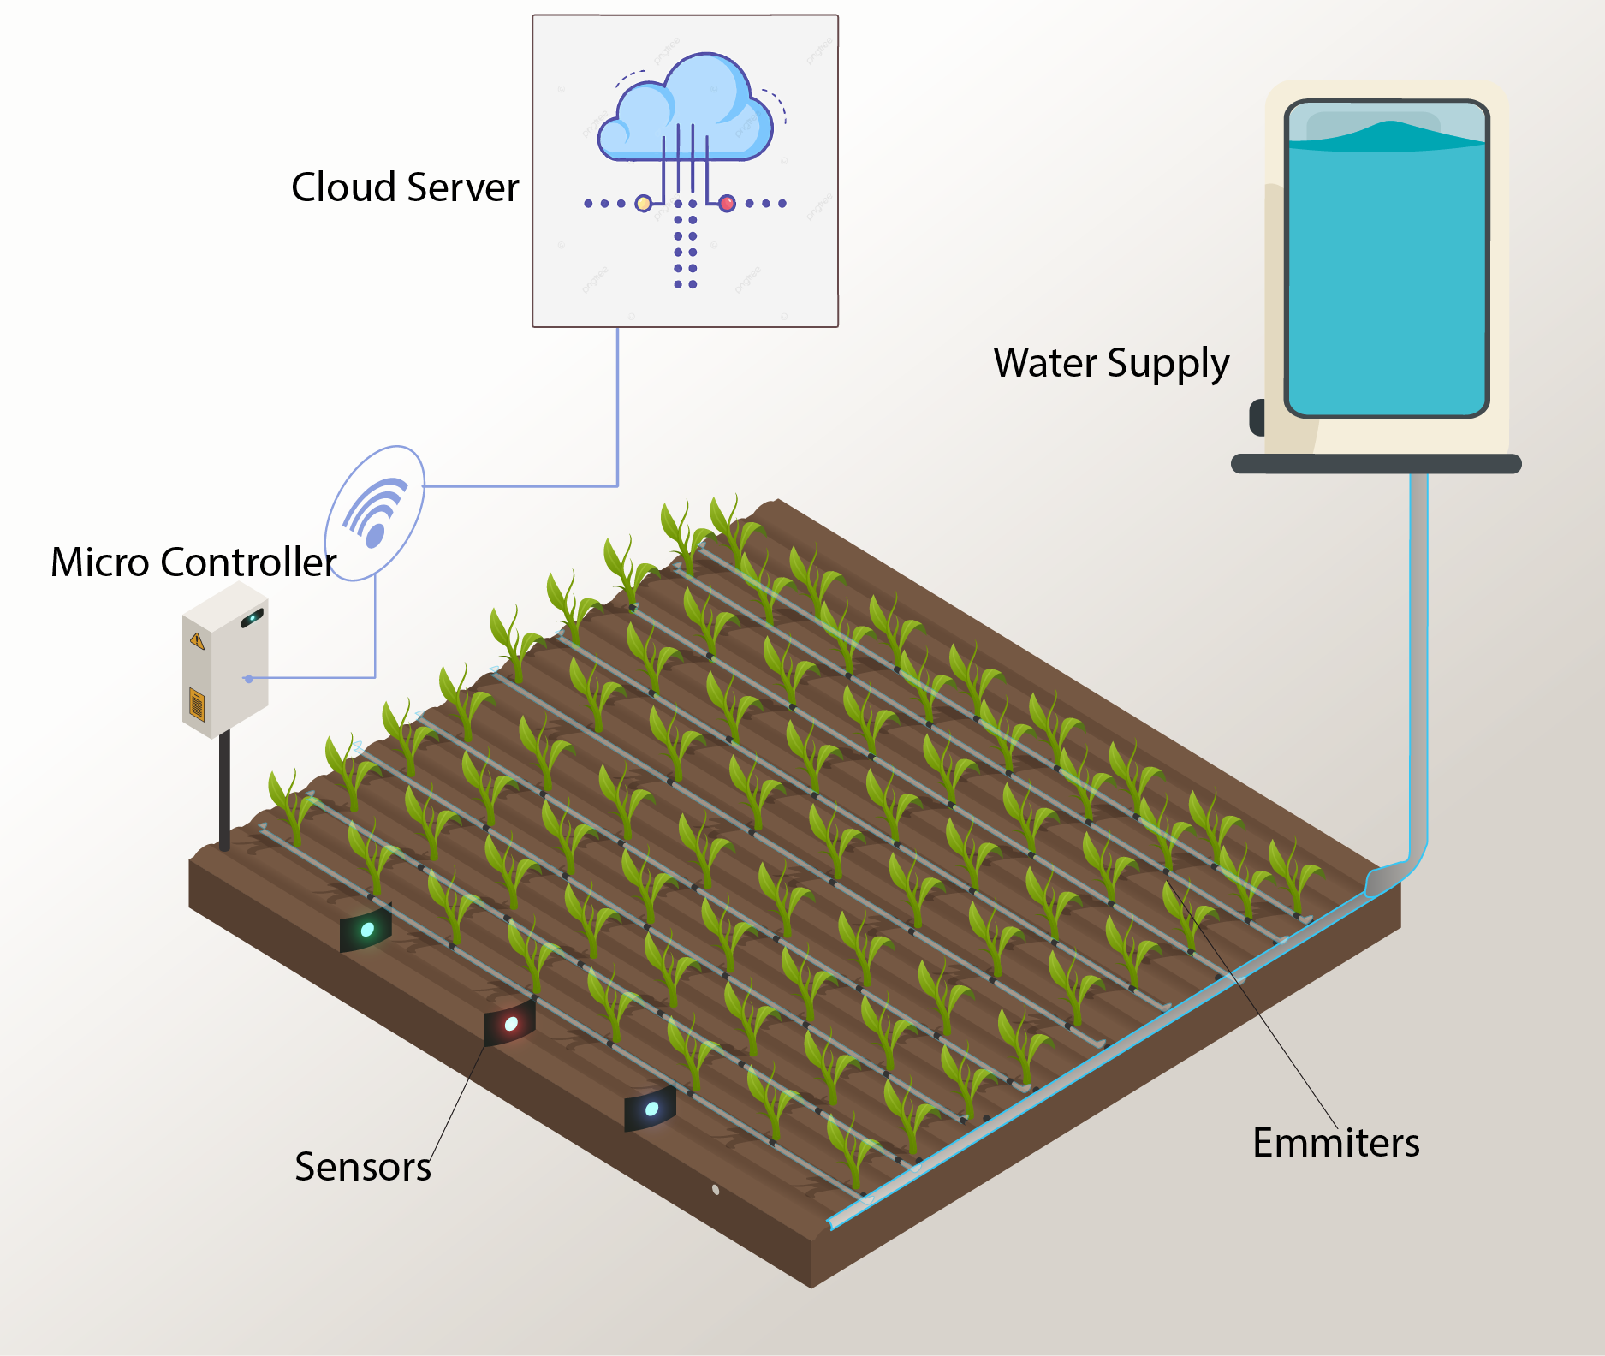
Simulation Setup
System Configuration
Environmental Conditions
Crop Water Requirements

Slide 8
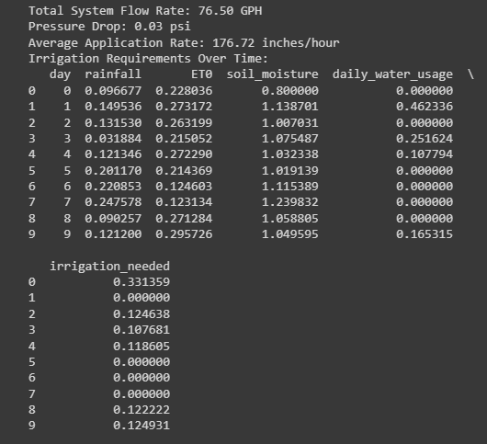
Results
Water Use Efficiency Analysis
Comparative Analysis

Slide 9
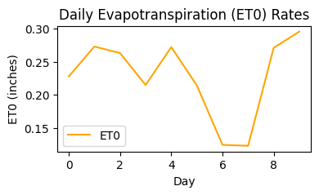
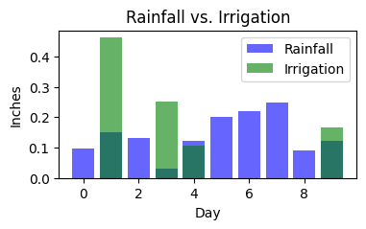
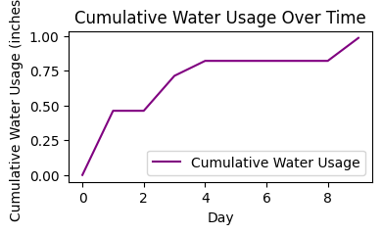
Results
Visualization Techniques

Slide 10
Discussion - Preliminaries
Purpose: Develop a Python-based computational model to assess water consumption efficiency in a drip irrigation system.
Libraries Used: Utilizes Matplotlib for visualization, Pandas for data handling, and NumPy for calculations.
Input Parameters: Includes discrete variables like emitter flow rates, system dimensions, and initial soil moisture.
Calculation Factors: Considers fixed parameters (e.g., pipe dimensions) and environmental aspects (e.g., crop water requirements).
System Configuration: Simulates a drip irrigation system with multiple emitters (0.5-1.0 GPH flow rates) on a 200-foot 0.75-inch diameter line.
Design Factors: Assumes a Hazen-Williams coefficient of 140 and 1-foot spacing between emitters and rows.
Soil Moisture Calculation: Computes soil moisture changes based on net moisture (rainfall minus evapotranspiration) and irrigation, assuming uniform soil properties.
Weather Simulation: Generates daily weather conditions with simulated rainfall (0 to 0.5 inches per day) and evapotranspiration rates (0.1 to 0.3 inches).
Crop Water Requirement: Adopts a standard crop water requirement of 1.0 inch per week for the simulation.

Slide 11
Discussion - Design
Developed a Python-based computational model for drip irrigation system efficiency evaluation.
Shifted from complex tools (Simulink, AnyLogic) to Python due to its simplicity and flexibility.
Utilized Matplotlib for visualization, Pandas for data handling, and NumPy for calculations.
Simulates and assesses drip irrigation efficiency by analyzing:
Daily soil moisture trends
Water presence in soil
Rainfall and irrigation interaction
Evapotranspiration rates
Cumulative water usage

Slide 12
Discussion - Simulation Setup
Crop Water Requirements
Crop water requirement: Standardized at 1.0 inch per week for various agricultural crops.
Daily irrigation requirements: Determined by combining this standard need with simulated environmental conditions.
Cultivation area: Fixed at 1000 square feet, serving as the basis for calculating total water volume necessary for effective irrigation.
Implementation of the Simulation
Simulation duration: Spans 10 days with daily executions.
Daily calculations: Include total system flow rate, pressure loss due to pipe friction, and water application rate.
Soil moisture update: Occurs daily based on net soil moisture change considering rainfall, ET0, and applied irrigation.
Compensation mechanism: If soil moisture drops below crop water needs, the system increases irrigation while considering a 70% efficiency rate.

Slide 13
Discussion - Simulation Setup
Along with accounting for both additional irrigation and natural rainfall, the model also tracks daily water usage. This information is essential for assessing how well the drip irrigation system uses and conserves water.

Slide 14
Discussion - Results
On Day 1, water usage stands at .46 inches. On Day 1, irrigation amount is calculated to be 0, and hence on Day 2, the daily water usage is found to be 0 too.
On Day 3, irrigation amount is calculated to be 0.12. As a result, the next day (Day 4), water usage stands at .25.
For Day 5,6,and 7, the irrigation amount is predicted to be 0. Hence, for Day 6,7,and 8, the water usage is also calculated to be 0. This is how the simulation continues for all 10 days.

Slide 15
Discussion - Results
On Day 1, water usage stands at .46 inches. On Day 1, irrigation amount is calculated to be 0, and hence on Day 2, the daily water usage is found to be 0 too.
On Day 3, irrigation amount is calculated to be 0.12. As a result, the next day (Day 4), water usage stands at .25.
For Day 5,6,and 7, the irrigation amount is predicted to be 0. Hence, for Day 6,7,and 8, the water usage is also calculated to be 0. This is how the simulation continues for all 10 days.

Slide 16
Future Work
AI & IoT Integration: Use AI and IoT to enable real-time data analysis and decision-making in the simulation for precise farming.
Customization: To guarantee the simulation's broad applicability, adapt it to different crops and geographical areas.
Mobile Access: Provide intuitive mobile user interfaces so that simulation tools can be easily accessed while traveling.
Resource Management Integration: To maximize the use of agricultural and water resources, integrate resource management techniques.

Slide 17
Conclusion
The Drip Irrigation System Simulation is a pivotal tool for agricultural transformation in water-scarce regions. It models weather conditions and soil moisture, aiding in understanding irrigation needs, system performance, and water usage. This simulation empowers users to optimize irrigation strategies, visualize crucial metrics, and supports sustainable agricultural practices, benefiting farmers, engineers, and researchers tackling water scarcity in farming.

Slide 18
Reference
F. Chen, N. Cui, S. Jiang, Z. Wang, H. Li, M. Lv, Y. Wang, D. Gong, and L. Zhao, “Multi-objective deficit drip irrigation optimization of citrus yield, fruit quality and water use efficiency using nsga-ii in seasonal arid area of southwest china,” Agricultural Water Management, vol. 287, p.108440, 2023.
E. A. Abioye, M. S. Z. Abidin, M. S. A. Mahmud, S. Buyamin, M. K. I.AbdRahman, A. O. Otuoze, M. S. A. Ramli, and O. D. Ijike, “Iot-based monitoring and data-driven modelling of drip irrigation system for mustard leaf cultivation experiment,” Information Processing in Agriculture, vol. 8, no. 2, pp. 270–283, 2021.
M. Cutini, C. Bisaglia, M. Brambilla, A. Bragaglio, F. Pallottino, A. Assirelli, E. Romano, A. Montaghi, E. Leo, M. Pezzola et al., “A co-simulation virtual reality machinery simulator for advanced precision agriculture applications,” Agriculture, vol. 13, no. 8, p. 1603, 2023.
N. Hashim, S. Mazlan, M. Aziz, A. Salleh, A. Jaafar, and N. Mohamad, “Agriculture monitoring system: a study,” Jurnal Teknologi, vol. 77, no. 1, pp. 53–59, 2015.
Y. Wang, S. Li, H. Liang, K. Hu, S. Qin, and H. Guo, “Comparison of water-and nitrogen-use efficiency over drip irrigation with border irrigation based on a model approach,” Agronomy, vol. 10, no. 12, p. 1890, 2020.
S. Munteanu, V. Sudacevschi, V. Ababii, R. Branishte, A. Turcan, and V. Leashcenco, “Cognitive distributed computing system for intelligent agriculture,” 2021.
O. Debauche, S. Mahmoudi, P. Manneback, and F. Lebeau, “Cloud and distributed architectures for data management in agriculture 4.0: Review and future trends,” Journal of King Saud University-Computer and Information Sciences, vol. 34, no. 9, pp. 7494–7514, 2022.
F. J. Ferr ́andez-Pastor, J. M. Garc ́ıa-Chamizo, M. Nieto-Hidalgo, and J. Mora-Mart ́ınez, “Precision agriculture design method using a dis- tributed computing architecture on internet of things context,” Sensors, vol. 18, no. 6, p. 1731, 2018.
Y. Wang, S. Li, Y. Cui, S. Qin, H. Guo, D. Yang, and C. Wang, “Effect of drip irrigation on soil water balance and water use efficiency of maize in northwest china,” Water, vol. 13, no. 2, p. 217, 2021.
F. Cassel Sharmasarkar, S. Sharmasarkar, S. Miller, G. Vance, and R. Zhang, “Assessment of drip and flood irrigation on water and fertilizer use efficiencies for sugarbeets,” Agricultural Water Management, vol. 46, no. 3, pp. 241–251, 2001. [Online]. Available: https://www.sciencedirect.com/science/article/pii/S0378377400000901
N. Pawar, D. K. Bishnoi, M. Singh, and A. Dhillon, “Comparative economic analysis of drip irrigation vis-a-vis flood irrigation system on productivity of bt. cotton in haryana,” Agricultural Science Digest-A Research Journal, vol. 35, no. 4, pp. 300–303, 2015.
C. K ̈uc ̧ ̈ukyumuk, E. Kac ̧al, A. Ertek, G. ̈Ozt ̈urk, and Y. S. K. Kurttas ̧, “Pomological and vegetative changes during transition from flood irri- gation to drip irrigation: Starkrimson delicious apple variety,” Scientia Horticulturae, vol. 136, pp. 17–23, 2012.

